Slide 1
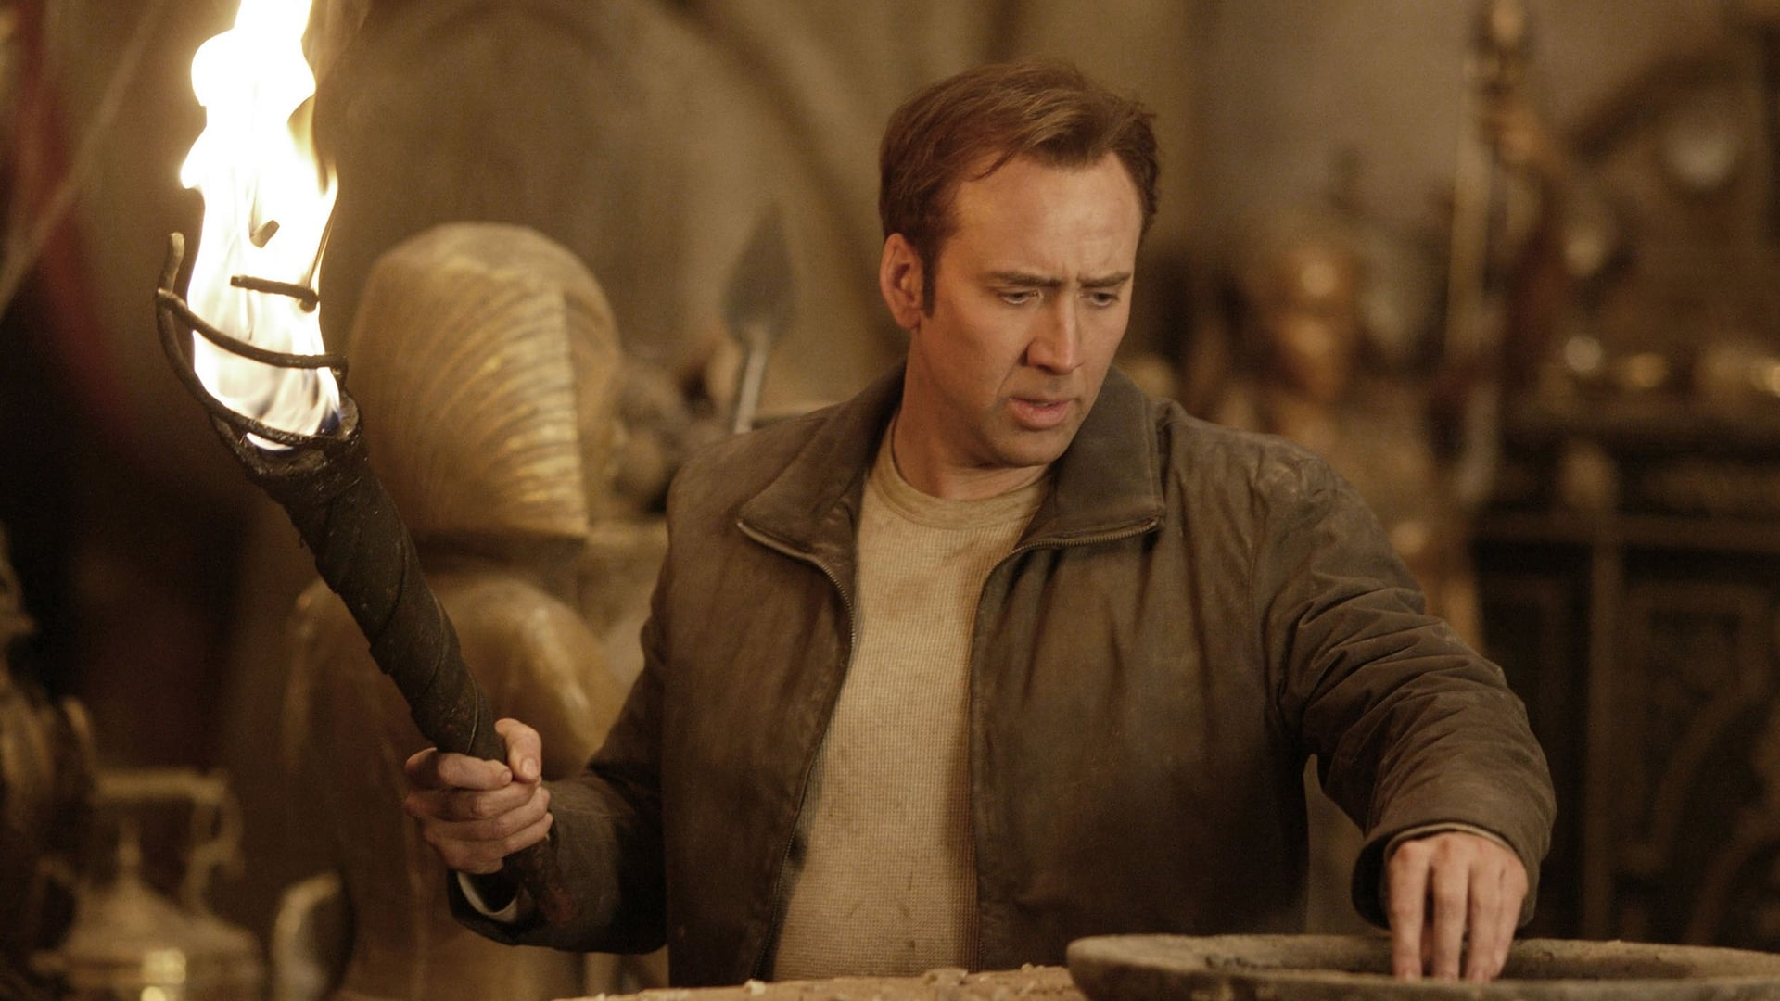


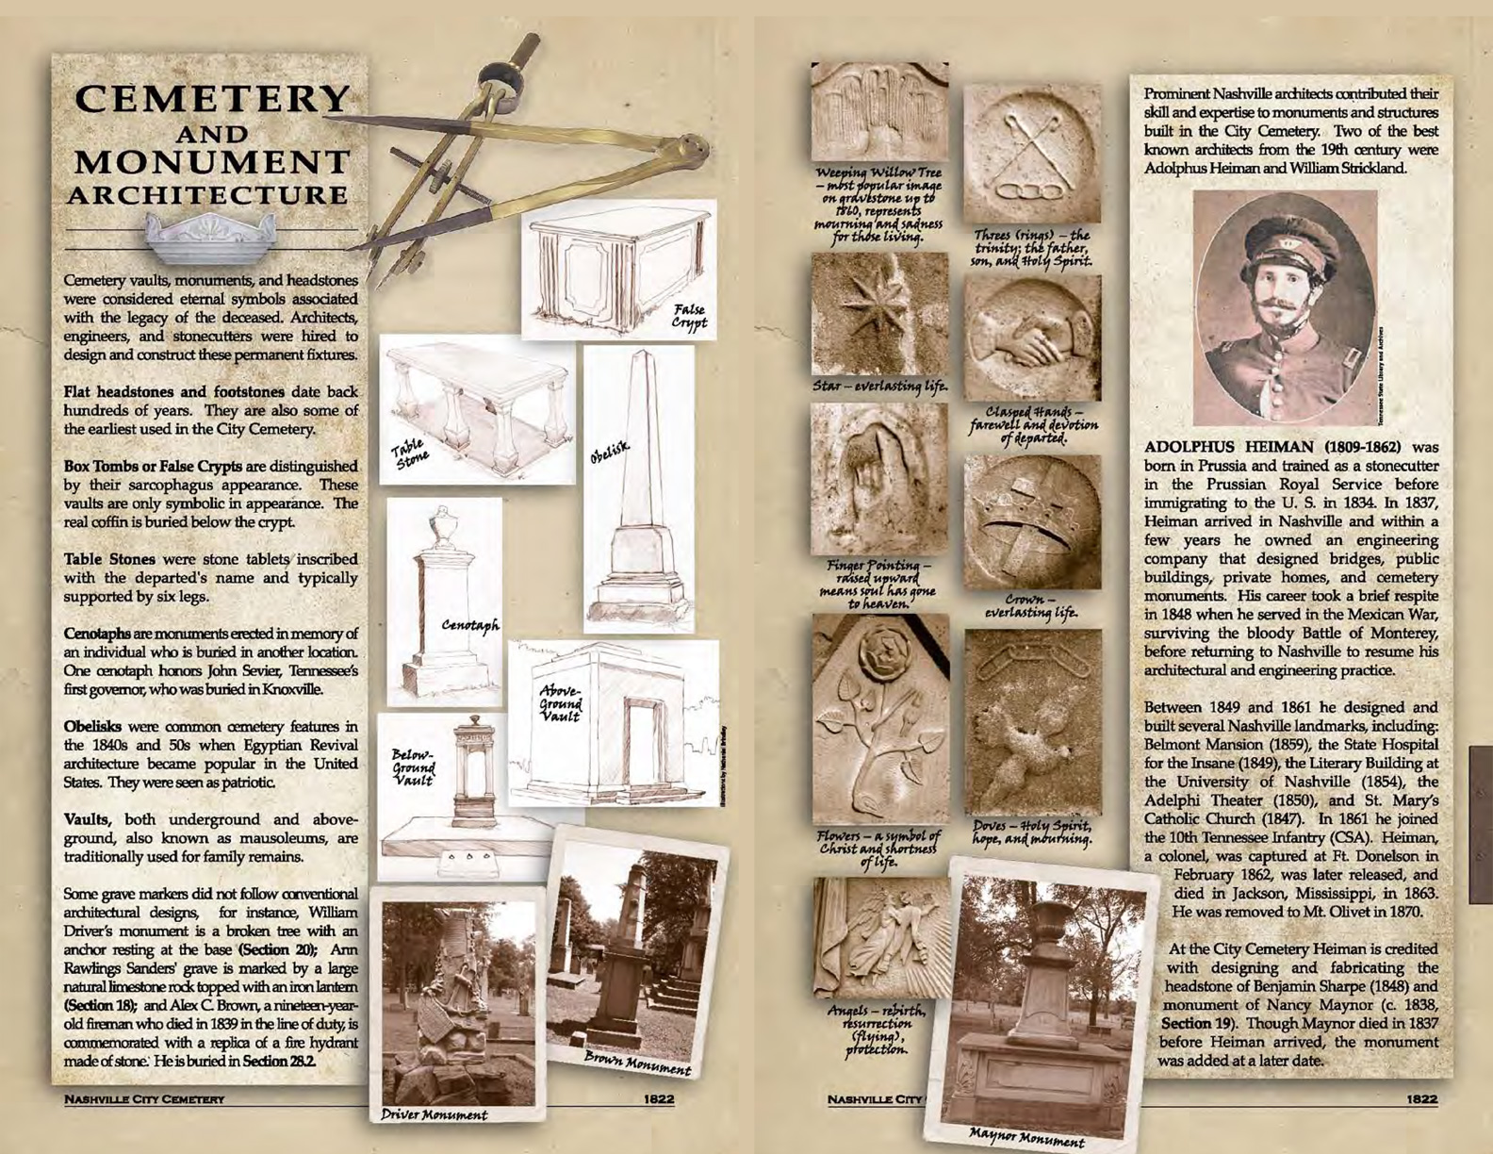

Nashville Treasure
Plots of Note:
Original burial site of President James K Polk
Grand Lodge Tennessee Free and Accepted Masons
Independent Order of Odd Fellows
Free and Unfree African Americans
American Revolutionary Soldiers
Civil War Soldiers and Confederate Generals
Symbols & Shapes to Look For:
Above-/Below-ground Vault
Obelisk-shaped Vault
Cenotaph
Clasped Hands
Angels & Doves
Weeping Willow Tree
Rings

